Slide 1
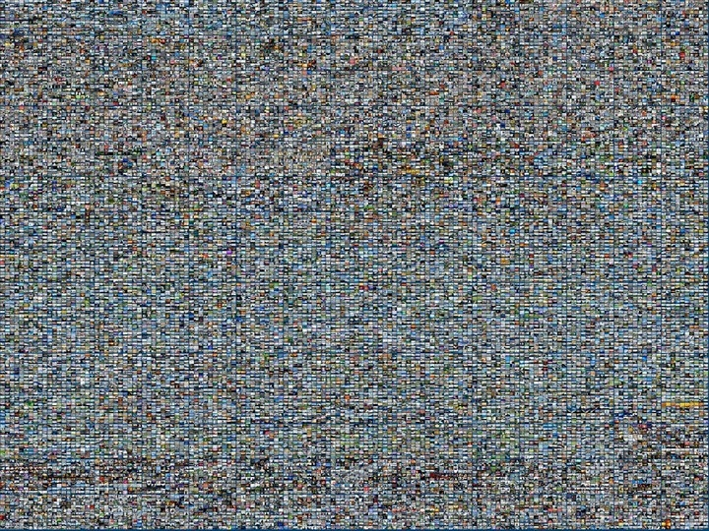
Données visuelles massives, partie 2
GIF-4105/7105 Photographie Algorithmique
Jean-François Lalonde

Slide 2
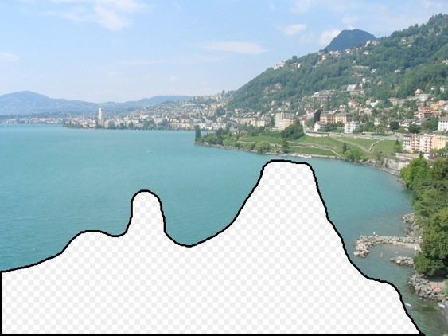
Qu’est-ce qu’il devrait y avoir dans la région?
Notes:
What should go here and why?

Slide 3
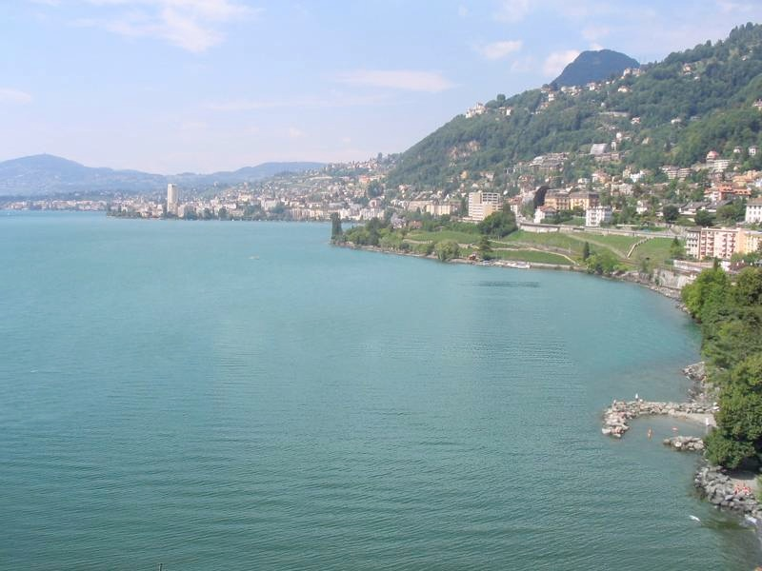

Slide 4
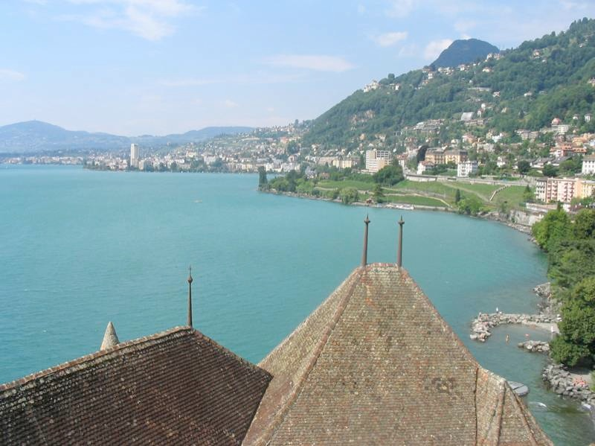

Slide 5
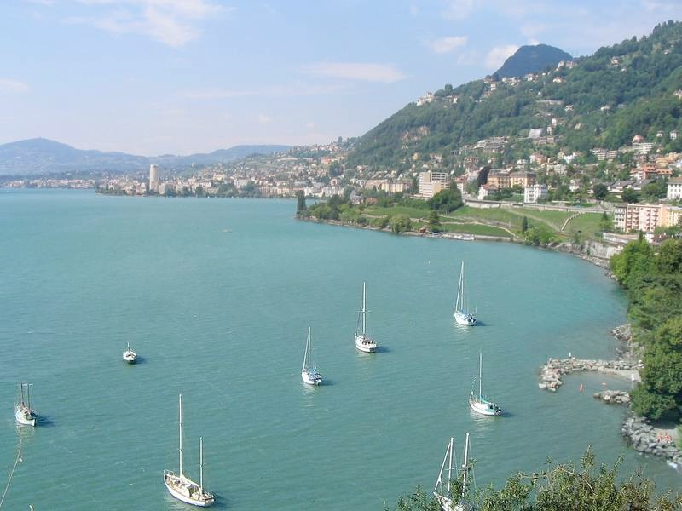

Slide 6
Quel est l’original?
(a)
(c)
(b)

Slide 7
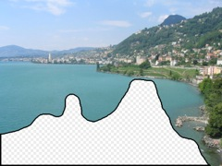
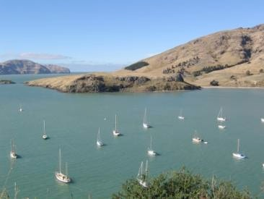
Comment ça marche
Trouver une image similaire dans une base de données
Copier une région dans le trou
Données

Slide 8
Utiliser beaucoup de données!
Base de
données
Information provenant des images similaires
Images
appariement
Image
Information
associée
Truc: si vous avez assez d’images, la base de données devrait contenir des images suffisamment similaires, faciles à trouver!

Slide 9
Combien d’images?

Slide 10
20,000 images

Slide 11
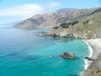
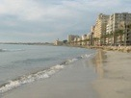
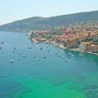
2,000,000 images

Slide 12
Aujourd’hui
Transférer de l’information
Emplacement GPS
Autre information (en fonction de l’emplacement)
Améliorer l’appariement
Apparier des portions de l’image
Déterminer ce qu’il faut apparier

Slide 13
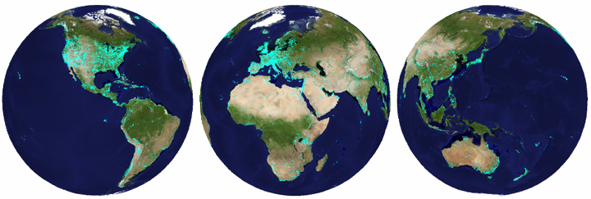
im2gps (Hays & Efros, CVPR 2008)
6 millions d’images avec GPS

Slide 14
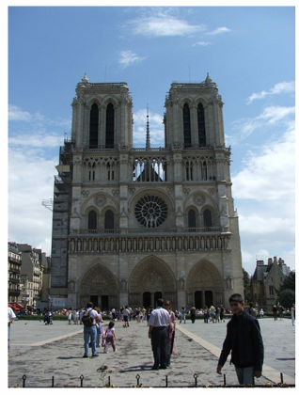
Quelle information géographique est disponible dans une image?

Slide 15
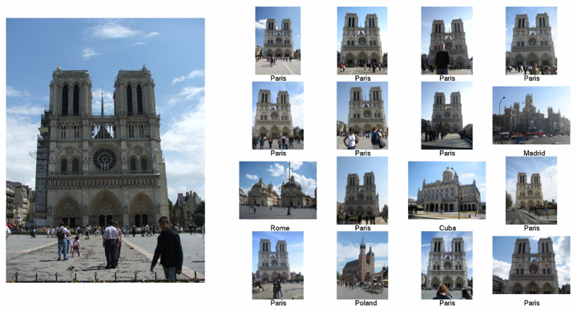

Slide 16
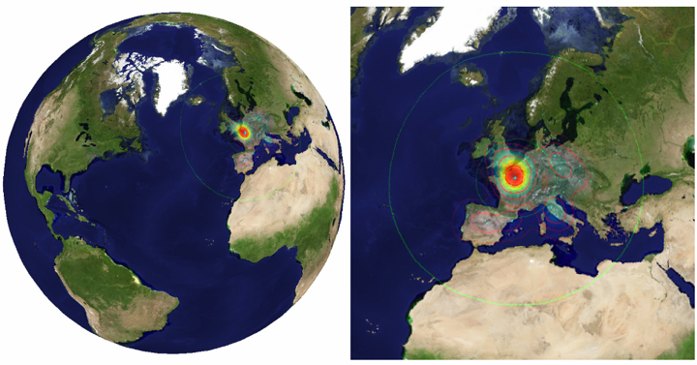

Slide 17
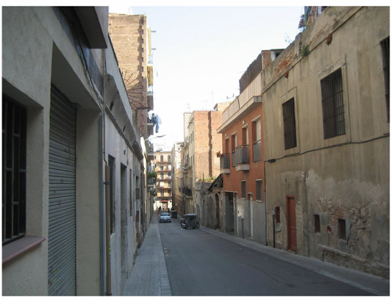

Slide 18
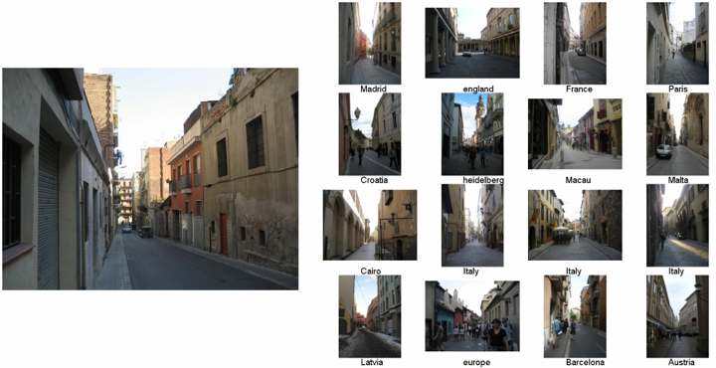
Exemples

Slide 19
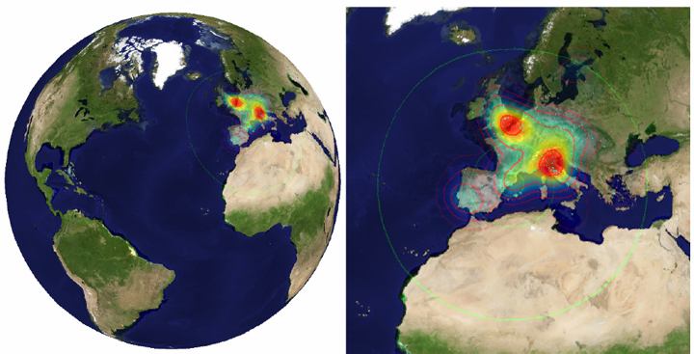
Votes
Notes:
Probability map for that same image
Explain the green circles and how they relate to evaluation

Slide 20
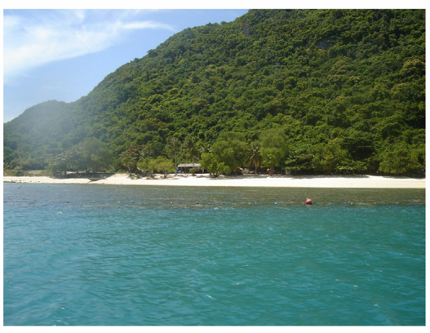

Slide 21
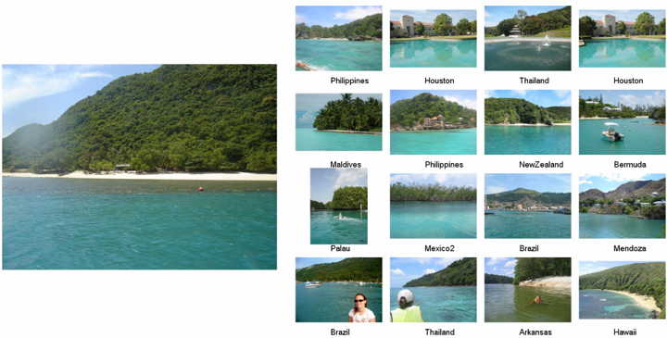

Slide 22
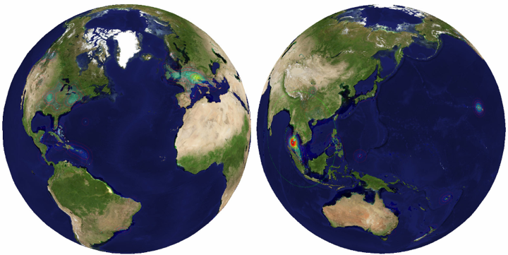

Slide 23
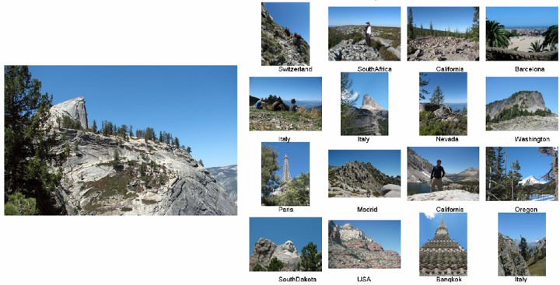

Slide 24
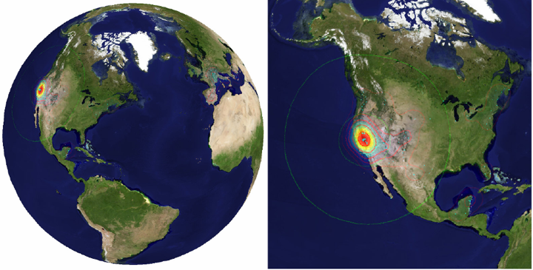

Slide 25
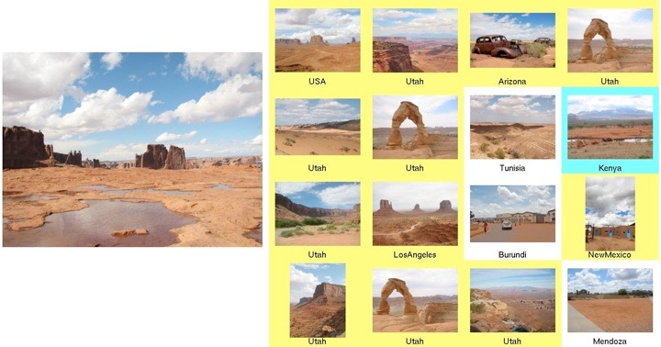

Slide 26
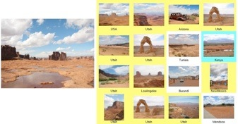
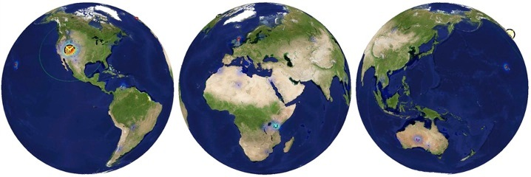

Slide 27
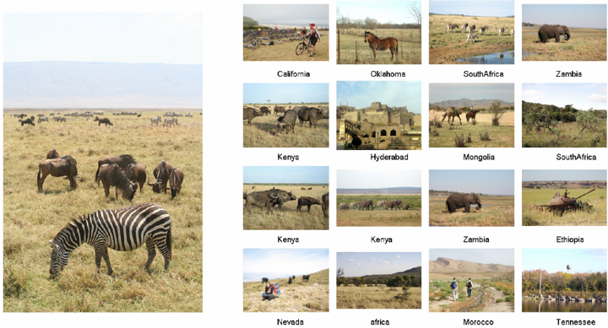
Notes:
Remember that the algorithm is not reasoning about the animals themselves! Yet we find a bunch of images that come from Africa.

Slide 28
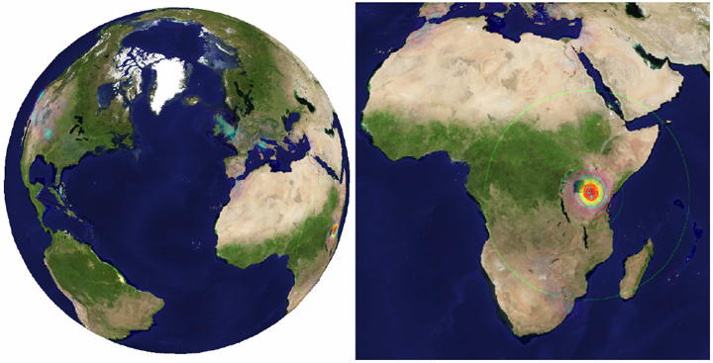

Slide 29
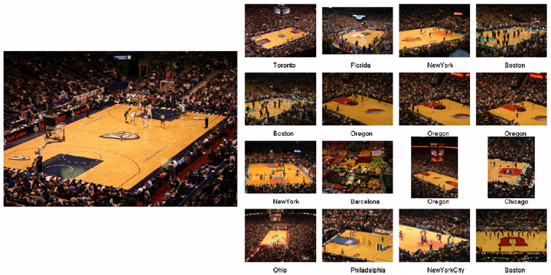

Slide 30
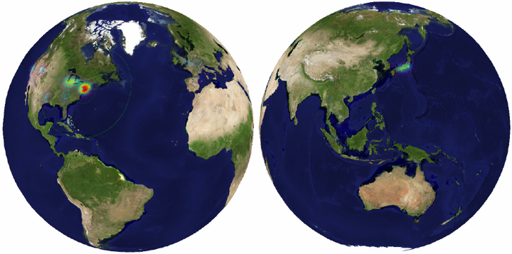

Slide 31
L’importance des données
Notes:
Need to report more than a number here, need to say it’s a surprising scientific result.

Slide 32
Data-driven categories
Notes:
Let’s consider this example...

Slide 33
Notes:
Even though the gps locations is ambiguous the *distribution* is informative.

Slide 34
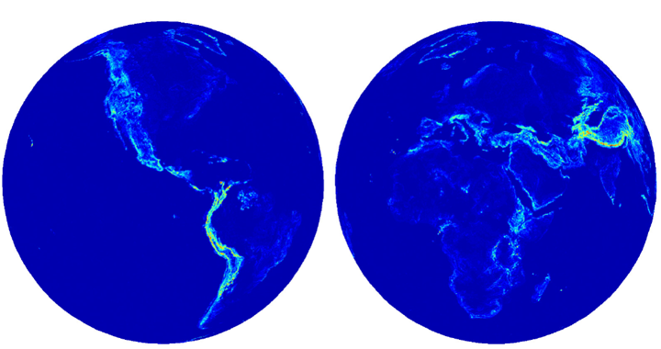
Elevation gradient = 112 m / km

Slide 35
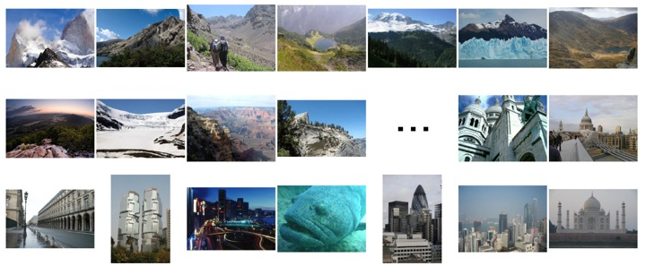
Elevation gradient magnitude ranking

Slide 36
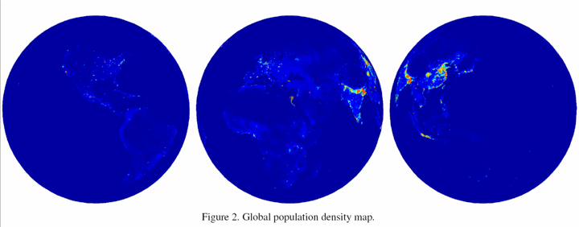

Slide 37
Population density ranking

Slide 38
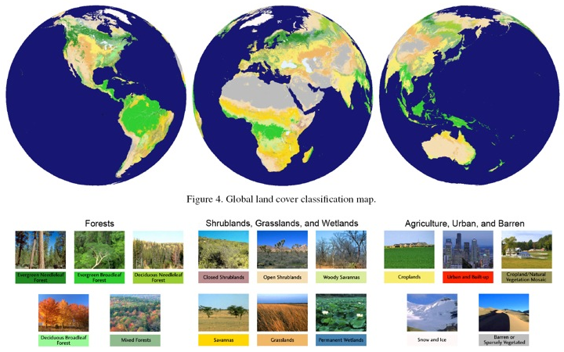

Slide 39
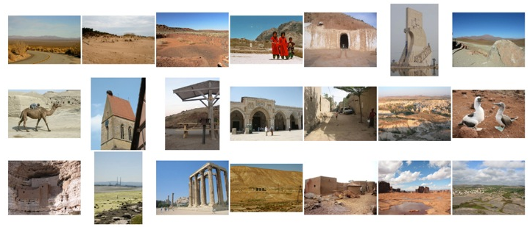
Barren or sparsely populated

Slide 40
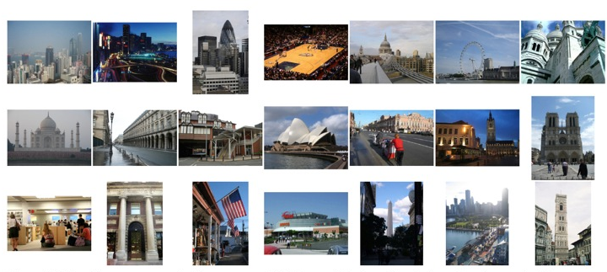
Urban and built up

Slide 41
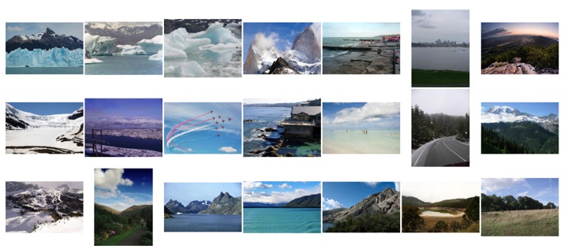
Snow and Ice

Slide 42
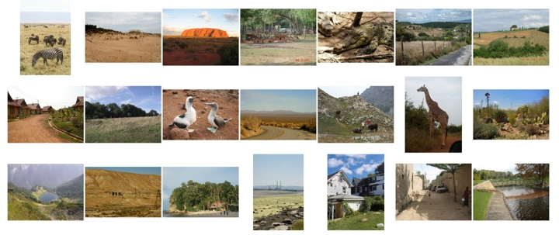
Savannah

Slide 43
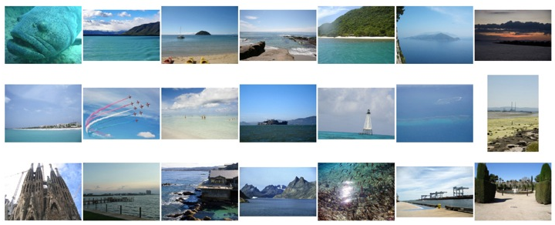
Water

Slide 44
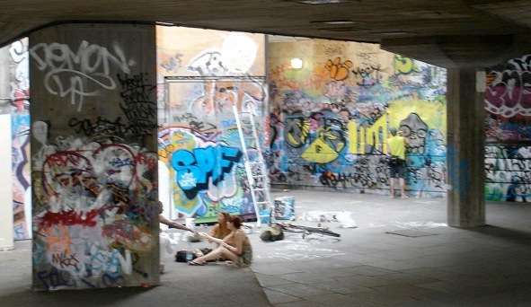
Où est-ce?
O. Vesselova, V. Kalogerakis, A. Hertzmann, J. Hays, A. A. Efros. “Image Sequence Geolocation,” ICCV 2009

Slide 45
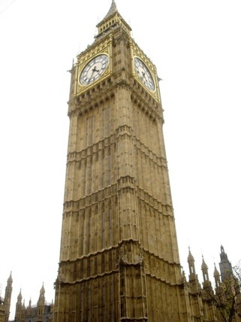
Où est-ce?

Slide 46
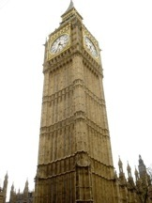
Où sont ces images?
15:14, June 18th, 2006
16:31, June 18th, 2006
Notes:
Individually each photograph is 16%, but together they reinforce each other well

Slide 47
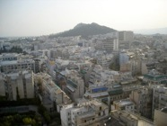
Où sont ces images?
15:14, June 18th, 2006
16:31, June 18th, 2006
17:24, June 19th, 2006
Notes:
If you know that brits love to vacation in greece…

Slide 48
Résultats (geo-loc < 400 km)
im2gps – 10%
temporal im2gps – 56%
Notes:
Not bad! But how can we do better?

Slide 49
Aujourd’hui
Transférer de l’information
Emplacement GPS
Autre information (en fonction de l’emplacement)
Améliorer l’appariement
Apparier des portions de l’image
Déterminer ce qu’il faut apparier

Slide 50
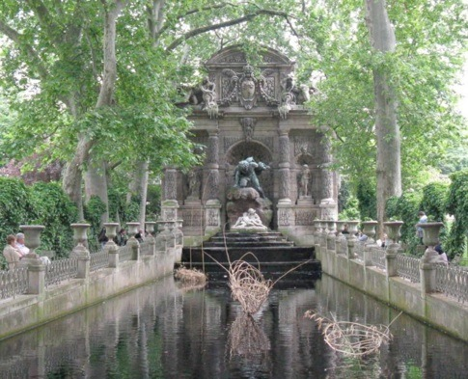
Fontaine de Médici, Paris
A. Shrivastava, T. Malisiewicz, A. Gupta, A. A. Efros, “Data-driven visual similarity for cross-domain image matching,” SIGGRAPH Asia 2011
2
Notes:
This is a photograph taken by my advisor of Medici fountain from Paris..
I really liked this photograph and wanted to find some similar images!
I thought of using Google’s recently launched Search-by-Image feature.. I took this image..

Slide 51
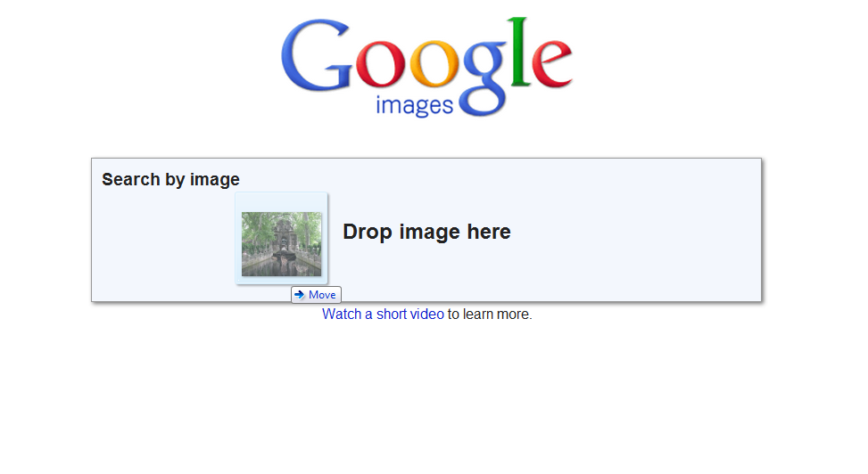
3
Notes:
Dropped it in google image search; It searches thru billions of images
And magically returns these matches..

Slide 52
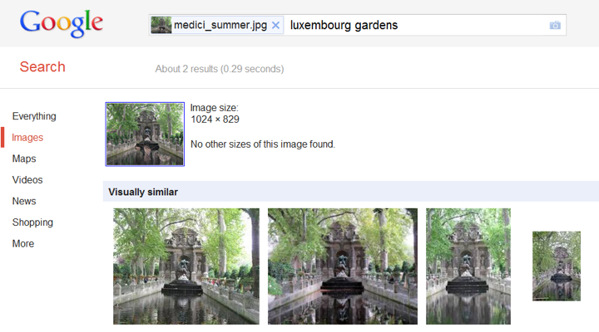
4
Notes:
Which look pretty good!
Great I thought!
How about this image?

Slide 53
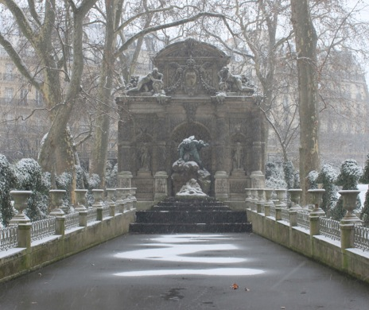
Medici Fountain, Paris (winter)
5
Notes:
Of the same place, the medici fountain..
Just from a different season.

Slide 54
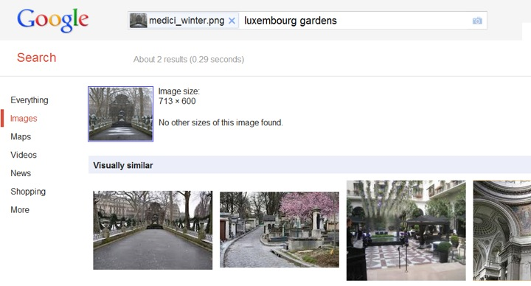
6
Notes:
These are the top matches by google..
The first match looks reasonable, but others are not as good.. Why so?
One explanation can be that it rarely snows in Paris. So images with snow at medici fountain are rare.. Ok..

Slide 55
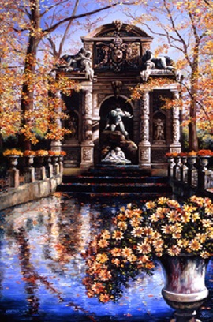
7
Notes:
What if I want to use this painting OF THE SAME PLACE, the medici fountain, to find similar images

Slide 56
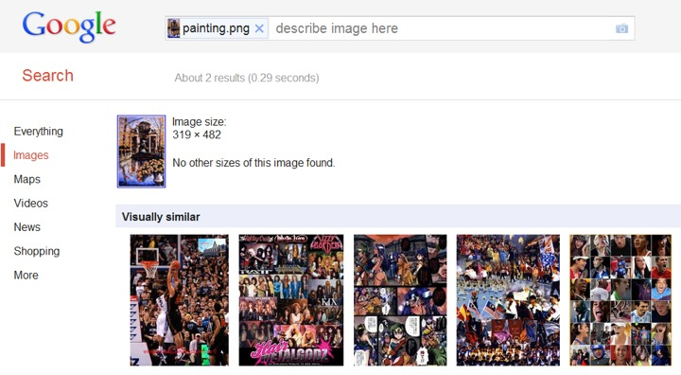
8
Notes:
The results are even worse…

Slide 57
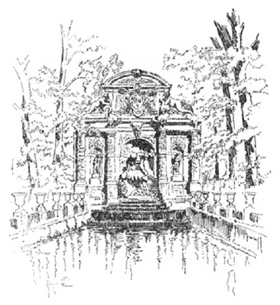
9
Notes:
What abt this sketch,
again of the same place medici fountain..

Slide 58
10
Notes:
No luck again…
In this work..

Slide 59
But
11
Notes:
In this work,
We propose a way to match images
Invariant to visual variations such as different seasons and even visual domains such as paintings or sketches.

Slide 60
Pourquoi c’est si difficile?
12
Notes:
Visual appearance – different @ Raw pixel level

Slide 61
Comparer les images
SIFT
(représentation des gradients
autour des coins)
GIST
(représentation des gradients
dans l’image)
Notes:
There has been lot of work in the field of image retrieval..
Starting from simple color-histogram based techniques to approaches that use SIFT and GIST descriptors..
But these usually work well

Slide 62
Exemple: appariement SIFT
14
[SIFT: Lowe, 2004]
Notes:
If the images are very similar to begin with..
For example, to matching these 2 image from medici fountain, Popular SIFT desc Works really well..
But

Slide 63
Exemple: appariement SIFT
15
[SIFT: Lowe, 2004]
Notes:
In case of these images of the exact same place, the medici fountain, just from a different season,
It fails miserably.
To handle this visual variations, different representations have been proposed before catering to specific domains, but none really works _across_ all domains at the same time.

Slide 64
17
Notes:
Given this illustration, we want to find matching images from a *very large dataset*
Gradient based matching approach.

Slide 65
Image
Plus proches voisins
18

Slide 66
Image
Plus proches voisins
19

Slide 67
Image
Plus proches voisins
20
Notes:
EVEN WORSE
But these are actually good matches for the computer because they do match something; just that these are not the matches that we humans want when we query this image.
It is that temple that we want to find, not the sky.
It is the temple that is important for humans to match in this image… But a computer has no way of knowing which are the important parts to match..

Slide 68
Image
Parties importantes
21
Notes:
What if an oracle marked important parts for us?
Then we can down-weigh the non important parts in this image while matching and retrieving images..

Slide 69
Plus proches voisins
Image
22
Notes:
Using same feature, these retrievals.. Present in the dataset
How do we find the interesting bits..

Slide 70
Utiliser les données pour
déterminer ce qui est unique
23
Notes:
We hypothesis that the things that are unique in this image are the things that do not occur freq in a large set of images. For example, the sky in this painting is not that unique because it occurs everywhere; however, it is the temple, that is less frequent, that is unique about this image. It is the temple that *separates* this image from this large set of natural world images. This is what we call “Data-driven Uniqueness”.
What we want is a separating boundary that separates this one image from this entire world of images. How we do it? Standard SVM machinery from ML – helps us find out what makes this different.

Slide 71
Qu’est-ce qui est unique?
25
Notes:
Simple synthetic example. Image of triangle and rectangle
Don’t know what is unique coz we don’t know how the world of images looks like.

Slide 72
Qu’est-ce qui est unique étant donné le monde?
World of Images
26
Notes:
How can computer figure this out?
Our idea is to use Support Vector Machine..
In a standard setting,

Slide 73
Support vector machine (SVM)
Class A
Class B
W₁
27
[Cortes and Vapnik, Machine Learning, 1995]
Notes:
In a standard setting, SVM is used classification, as a
Discriminative classifier which tells us which features in class A make it different from class B.

Slide 74
Per-exemplar SVM
World of Images
Image₁
W₁
W₂
Image₂
[Malisiewicz et al., ICCV, 2011]
28
Notes:
What if I had a single image instead of class A?
How the single image is different from class B?

Slide 75
Histogram of oriented gradients (HOG)
29
[Dalal and Triggs, CVPR, 2005]

Slide 76
Visualizer ce qui est unique
Query
Before
After
World of Images
30
Notes:
HOG before and after
Ask the computer to “pick” which of the gradients in the image are important. Which one make this image look _different_ from all the others.

Slide 77
HOG
Top Match
Input Query
Learnt Weights
Top Match
31
Notes:
In the top example, the vertical structures are dominating, so the top match also contains strong vertical structures.
After learning, the algorithm determined that the vertical structures aren’t really what’s making this image different than the rest of the world: it’s what’s going on in the lower left part of the image (bridge), and some other discriminative regions, like edges w/ the sky and the river.

Slide 79
Sketch based Image Retrieval

Slide 80
Painting based Image Retrieval

Slide 81
painting2gps

Slide 82
Results
http://youtu.be/PY__Fo4o67I?t=1m15s

Slide 83
Les Dangers des Données

Slide 84
Biais
Internet contient un nombre énorme d’images (Flickr, YouTube, Picasa, etc.)
Les images ne sont pas échantillonnées aléatoirement
Plusieurs sources de biais:
Échantillonnage
Photographe
Social

Slide 85
Flickr Paris

Slide 86
Vrai Paris

Slide 87
Vraie Notre Dame

Slide 88
Biais d’échantillonnage
Nous aimons prendre des photos en vacances

Slide 89
Biais d’échantillonnage
Nous aimons prendre des photos en vacances

Slide 90
Biais du photographe
Nous voulons que nos photos soient intéressantes, ou reconnaissables!
vs.

Slide 91
Biais du photographe
Conventions photographiques
vs.

Slide 92
Biais social
“100 Special Moments” by Jason Salavon

Slide 93
Biais Social
Mildred and Lisa
Source: U.S. Social Security Administration
Gallagher et al CVPR 2008
Notes:
Who’s who?

Slide 94
Biais social
Notes:
Birds naturally space themselves on a wire.
Taller people (often guys) are place in the back.
Person of honor or importance (e.g. grandma) is in the middle of the photo.

Slide 95
Limiter le biais
Street side
Google StreetView
Satellite google.com
Webcams
Capture autonome réduit le biais
On en a toujours un peu…

Slide 96
Survol
Base de
données
Information provenant des images similaires
Images
appariement
Image
Information
associée
Truc: si vous avez assez d’images, la base de données devrait contenir des images suffisamment similaires, faciles à trouver!

